Slide 1
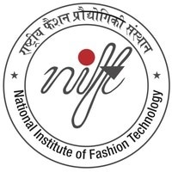
UG IDM
The Department of Knitwear Design

Slide 2
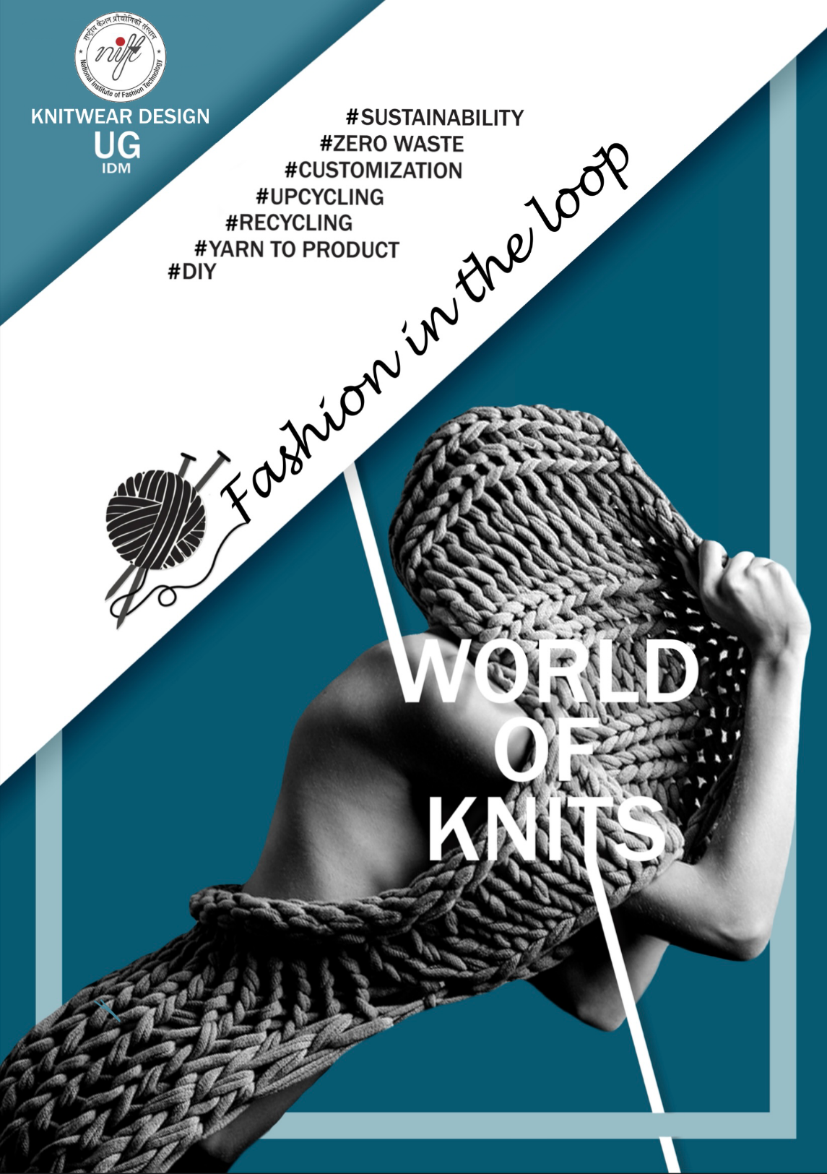

World
of knits

Slide 3
Pathway Mapping
World of Knits | Semester
Introduction to World Knitting | 3
Knit Fabric Studies | 4
Knit for Apparels | 5
Knit for Home | 6
Knit Art | 7

Slide 4
World of Knits: An understanding of knits as a zero waste, sustainable product.
Keywords –
Design
Aesthetics
Hand knitting
Hand flat knitting
Sustainability
Zero Waste
Recycling
Up-cycling
Customization
The versatility of knits as a medium
Yarn to Product.

Slide 5
World of Knits
Introduction to World Knitting (Sem-3):
History & Evolution.
Basics of Hand Knitting, Structures.
Styles & Techniques across the world.
Development of Creative Swatches in Hand Knitting.

Slide 6
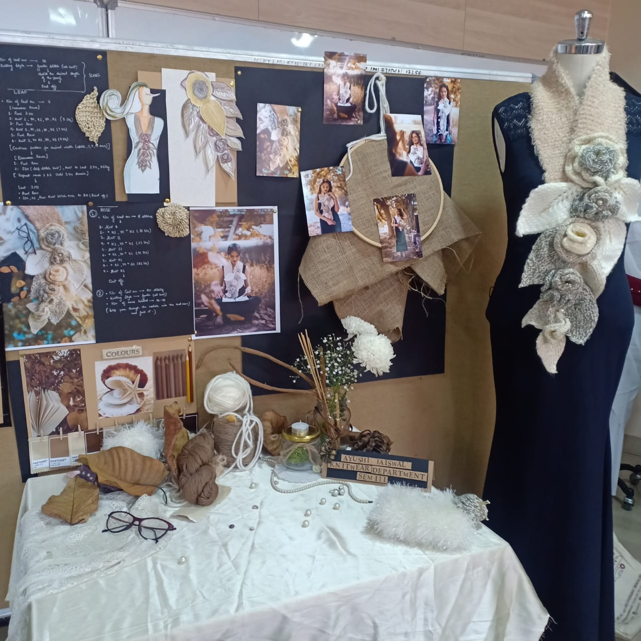
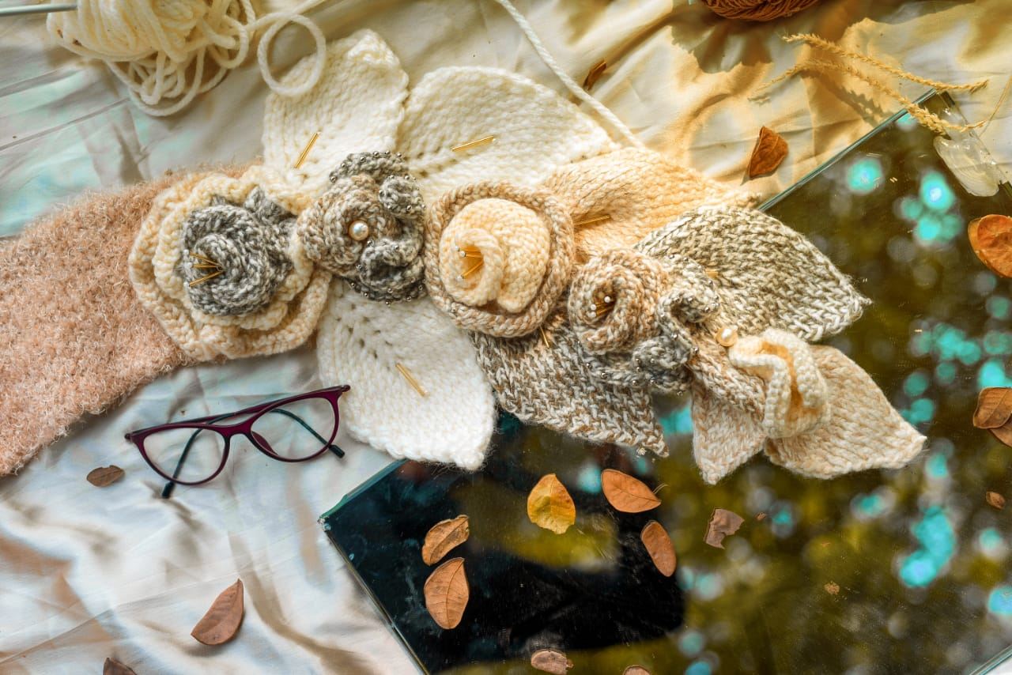
SEM – 3 (Introduction to world knits)

Slide 7

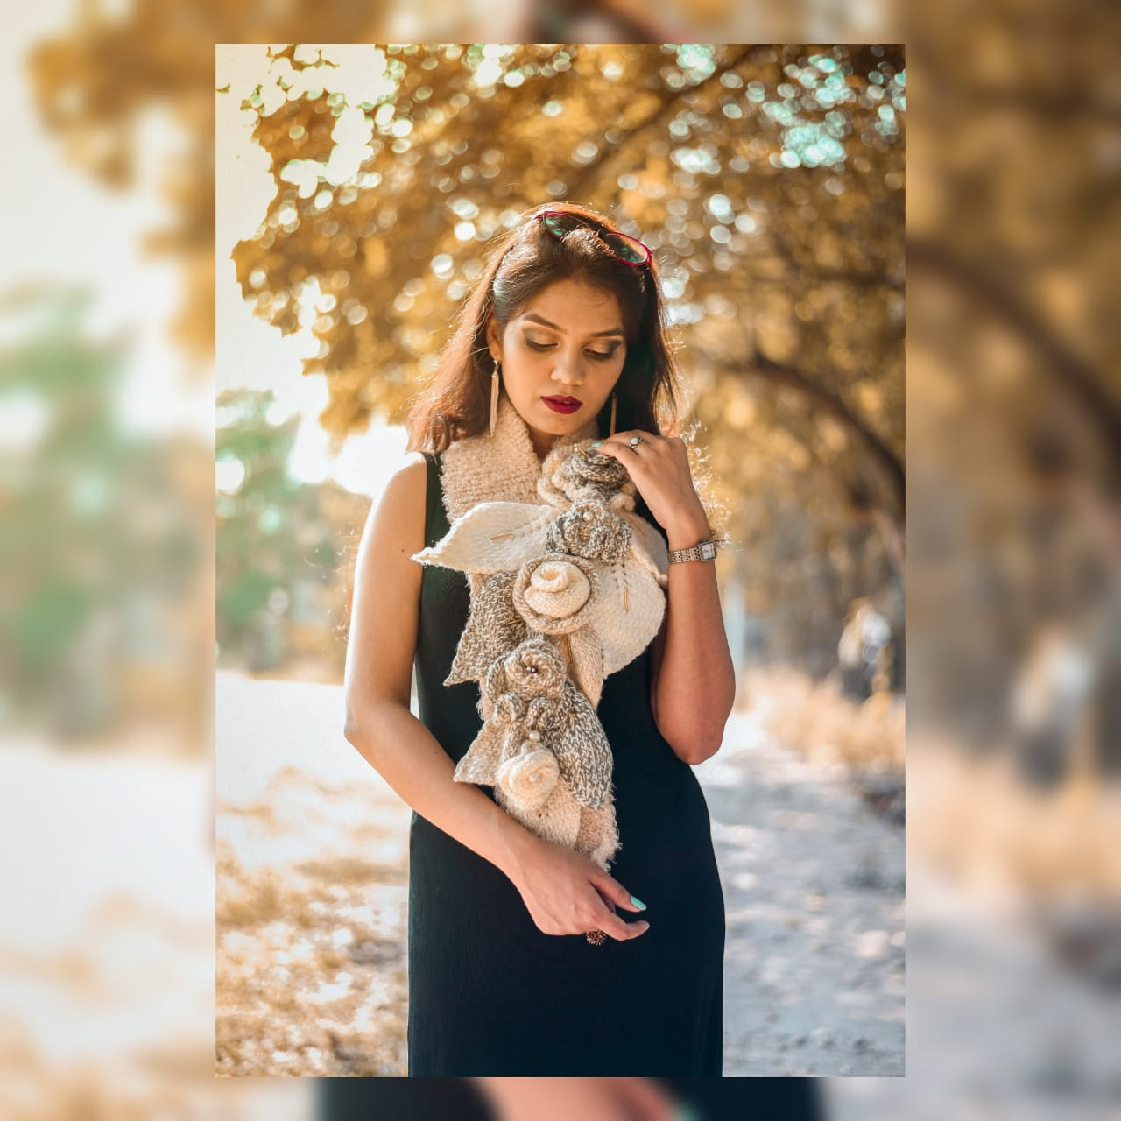
SEM – 3 (Introduction to world knits)

Slide 8
World of Knits
Knit Fabric Studies (Sem-4):
Fabrics for Fashion categories
Classification of Knit Fabrics- Flat/Circular/Computerized
Knit stitches
Basic structures on flat knit machine
Material exploration
Creative swatches.

Slide 9
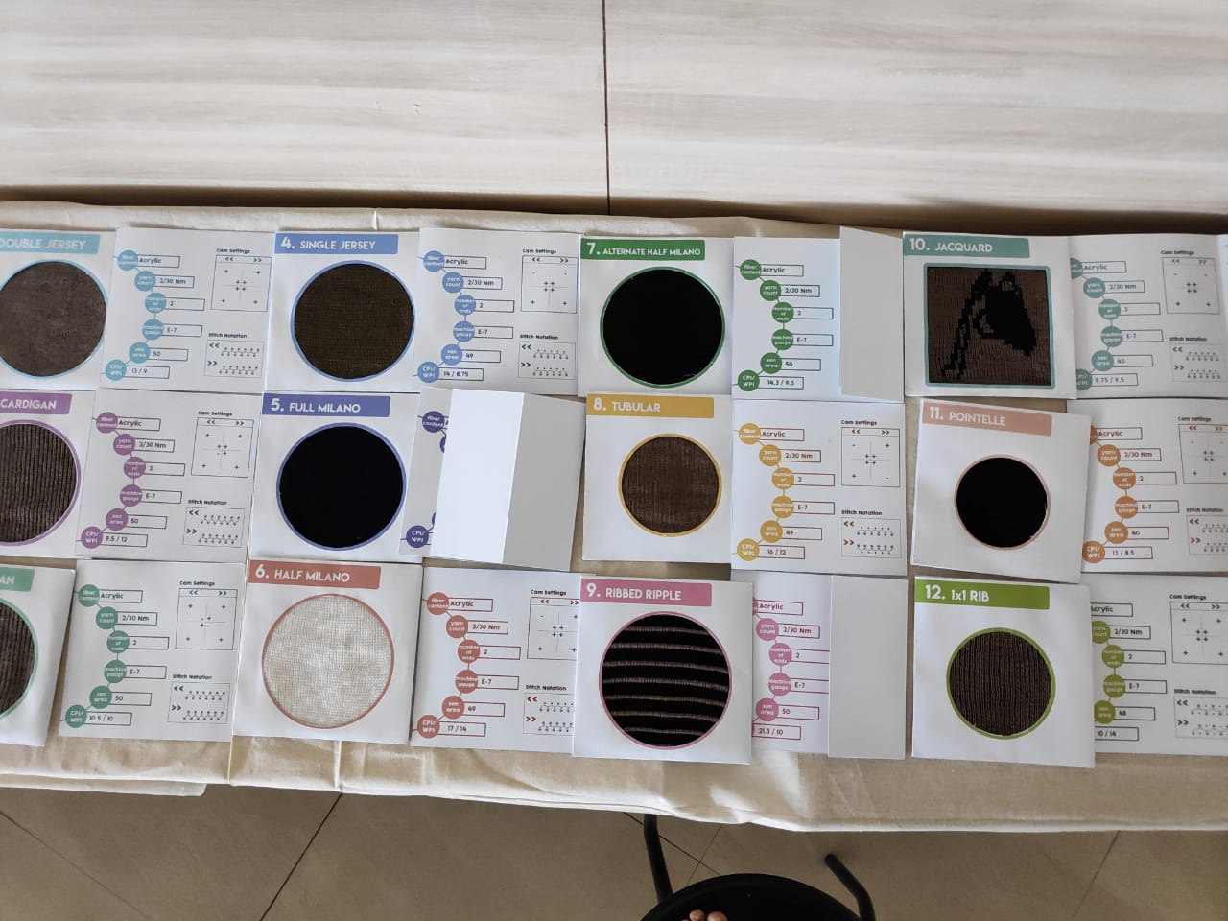
Sem – 4 Knit fabric Studies

Slide 10
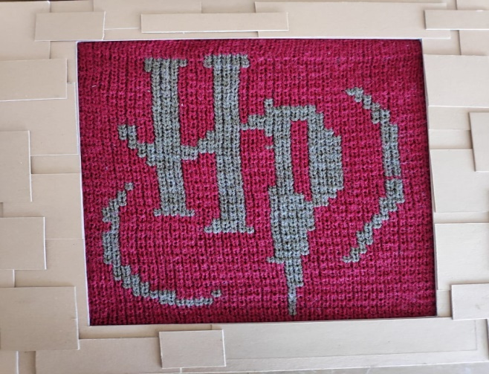
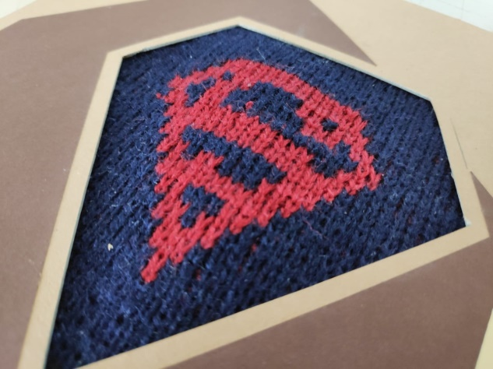
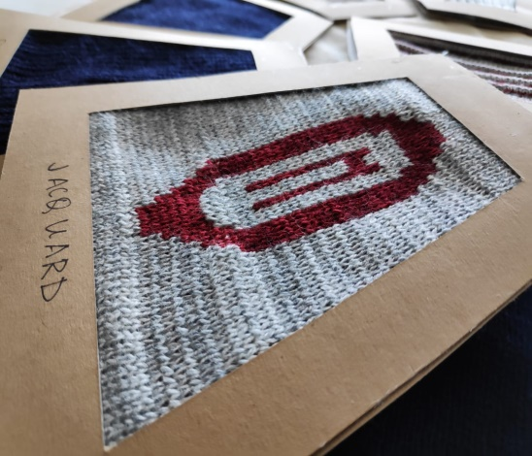
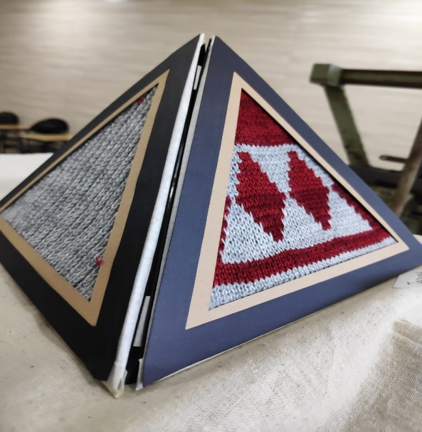
Sem – 4 Knit fabric Studies

Slide 11
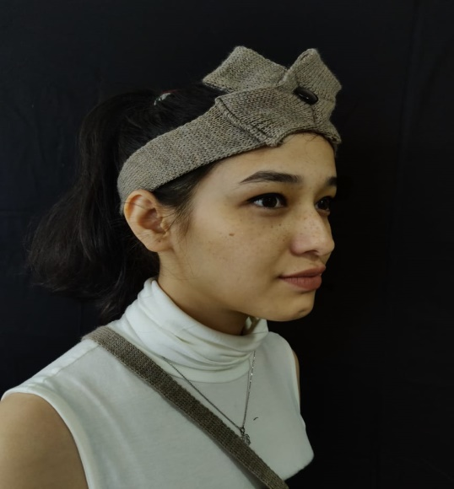
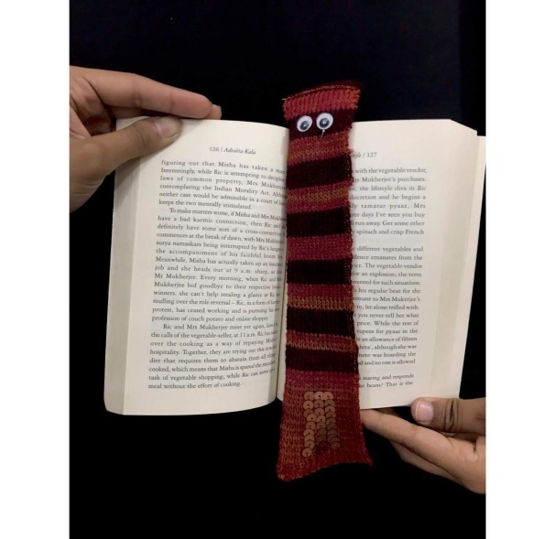
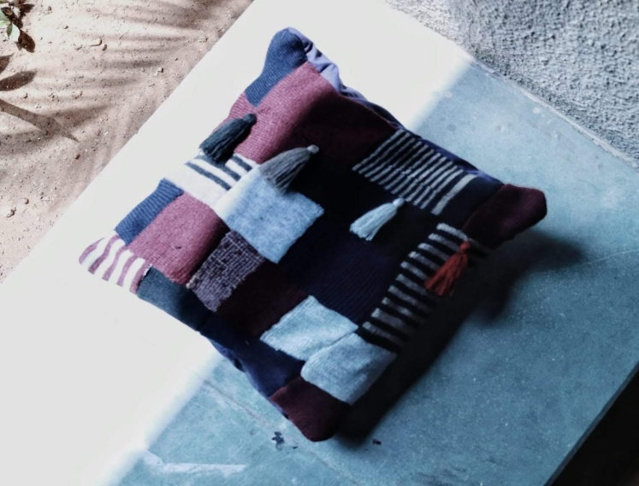
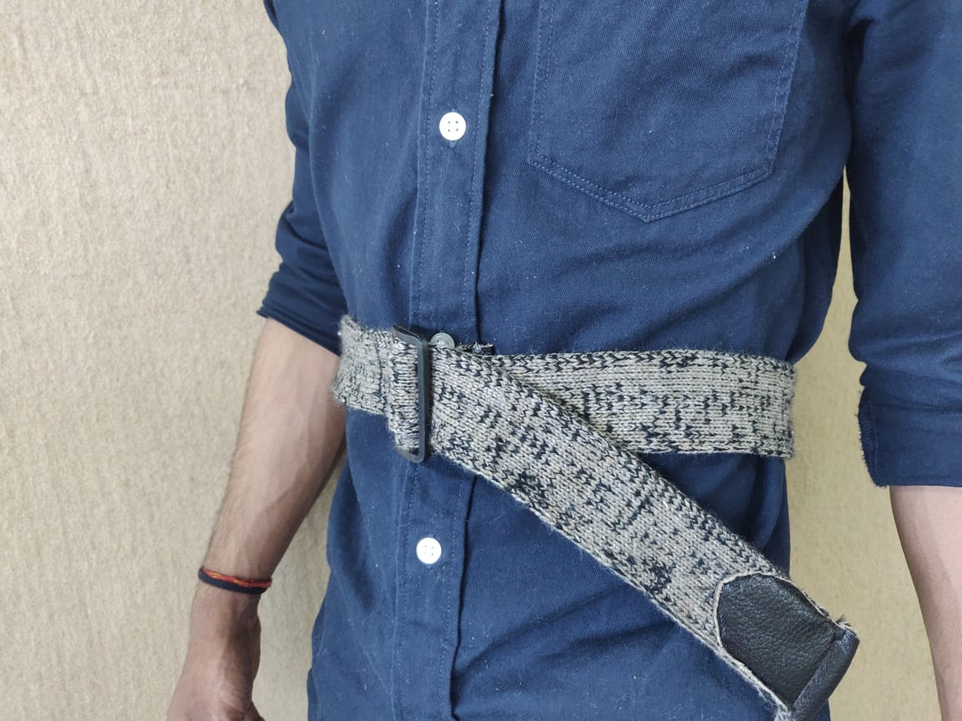
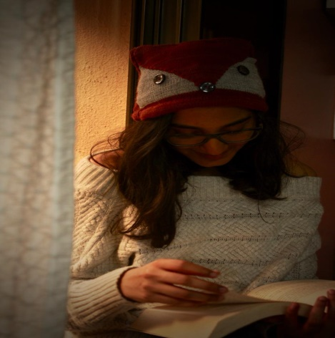
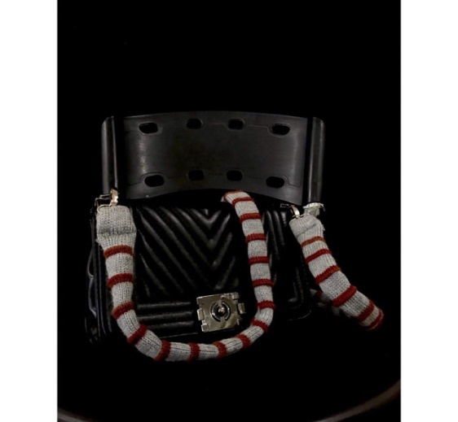
Sem – 4 Knit fabric Studies

Slide 12
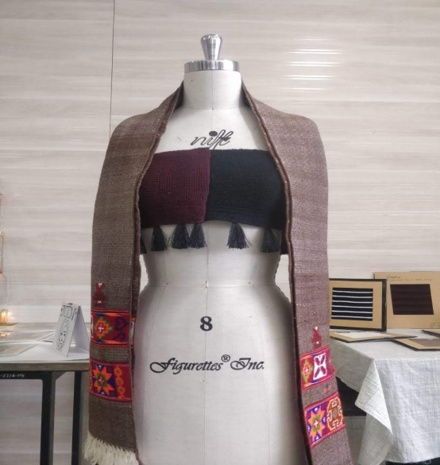
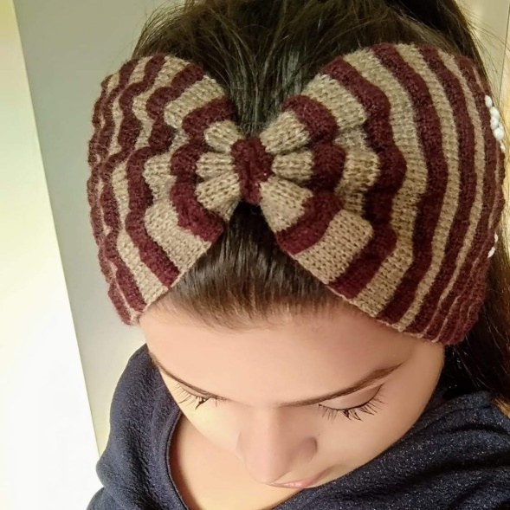
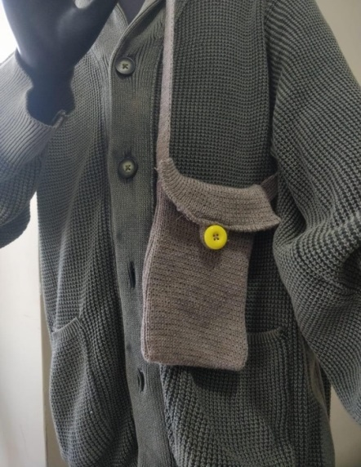
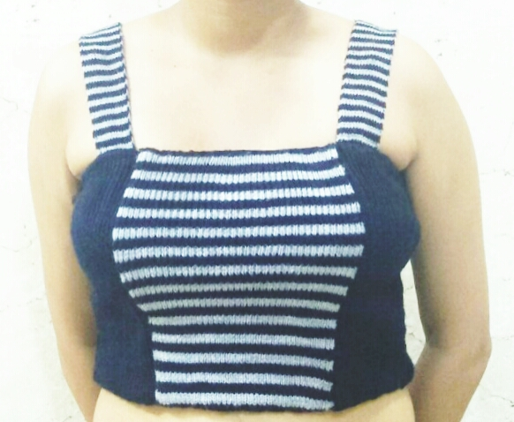
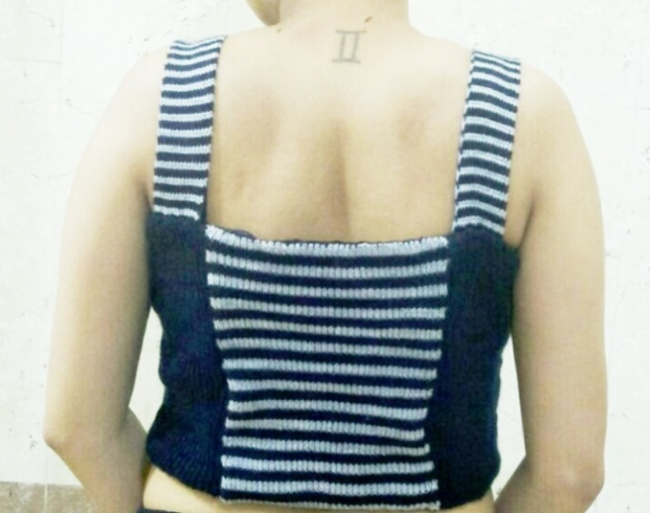
Sem – 4 Knit fabric Studies

Slide 13
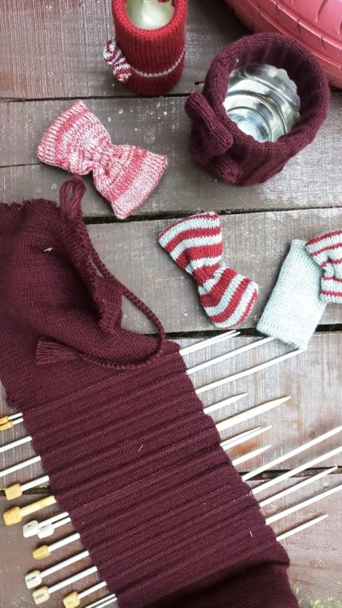
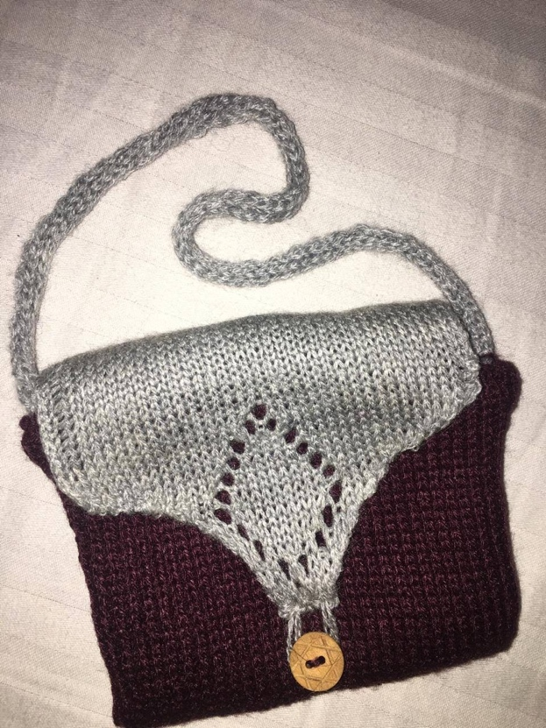
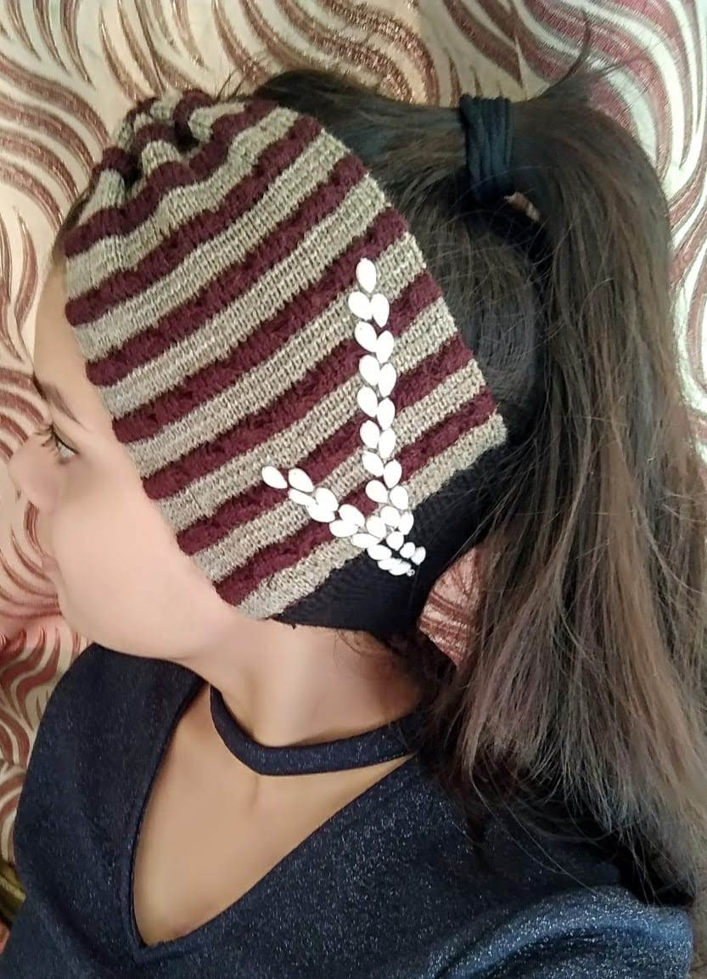
Sem – 4 Knit fabric Studies

Slide 14
World of Knits
Knit for Apparels ( Sem 5):
Sustainable Product Development:
Using different yarns
Leftover fabrics & trims
Customized knitted garment with zero waste.

Slide 15
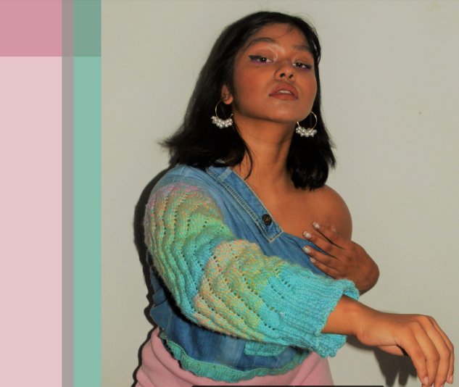
Sem – 5 Knits for apparels

Slide 16
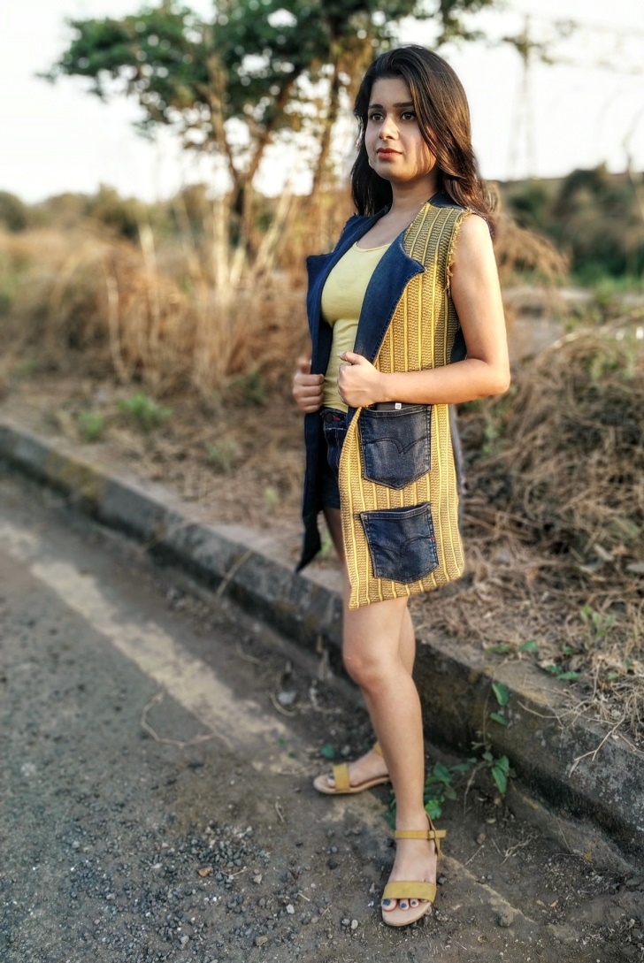
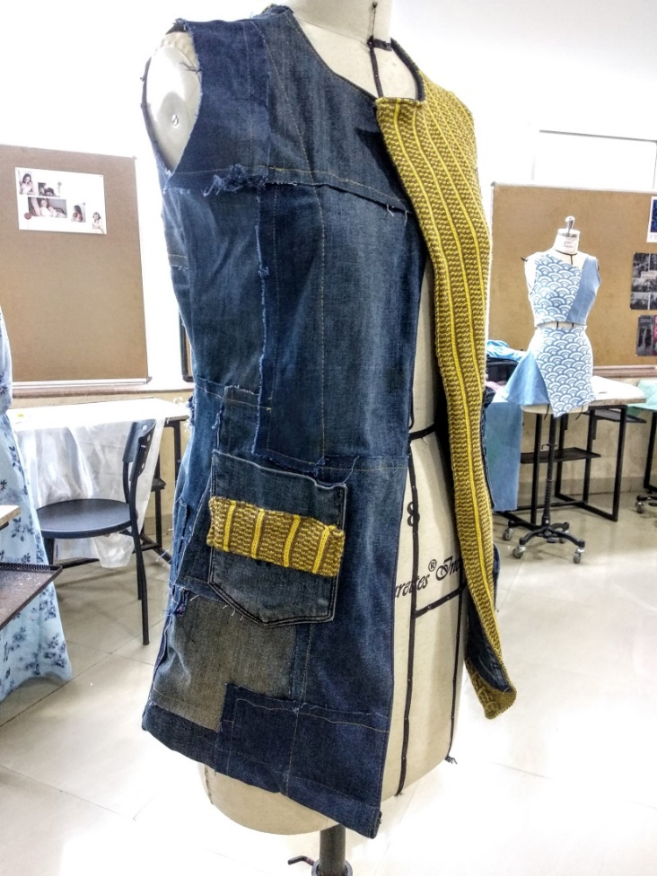
Sem – 5 Knits for apparels

Slide 17
World of Knits
Product Development for Home Fashion (Sem-6):
Sustainable Product Development:
Using different yarns
Leftover fabrics & trims
Development of Home Fashion Products & Accessories keeping sustainability/ Zero waste into consideration.

Slide 18
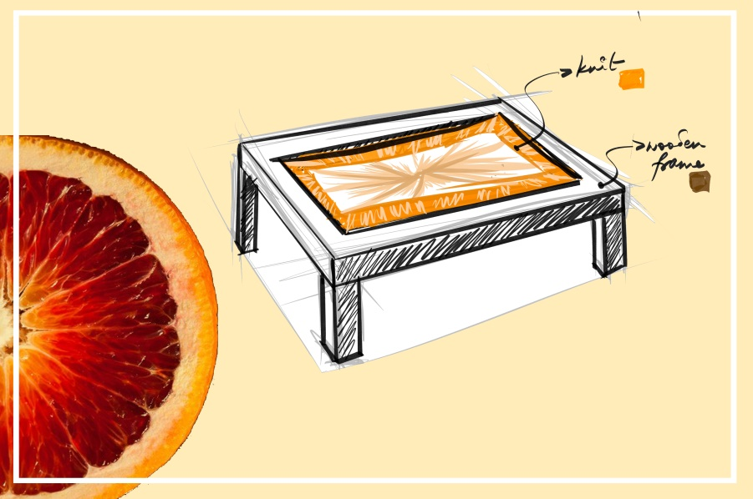
Sem– 6 Product Development For Home Fashion

Slide 19
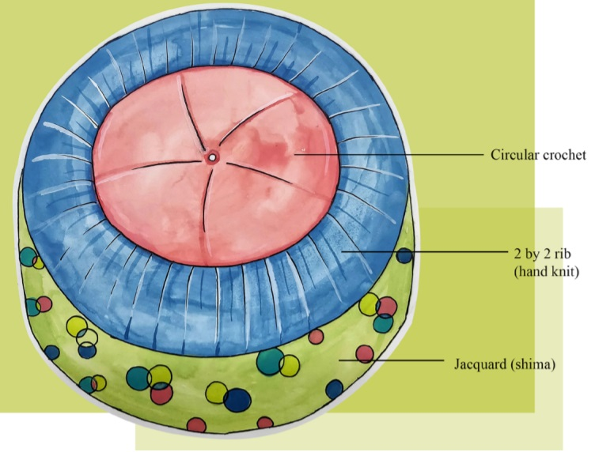
Sem– 6 Product Development For Home Fashion

Slide 20
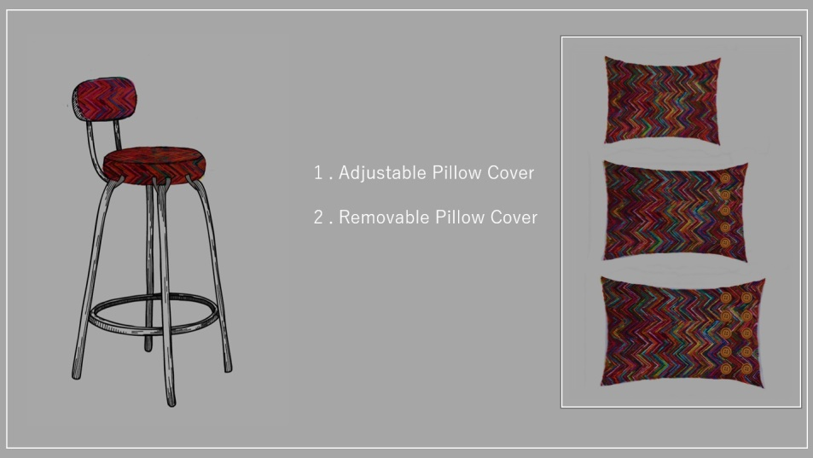
Sem– 6 Product Development For Home Fashion

Slide 21
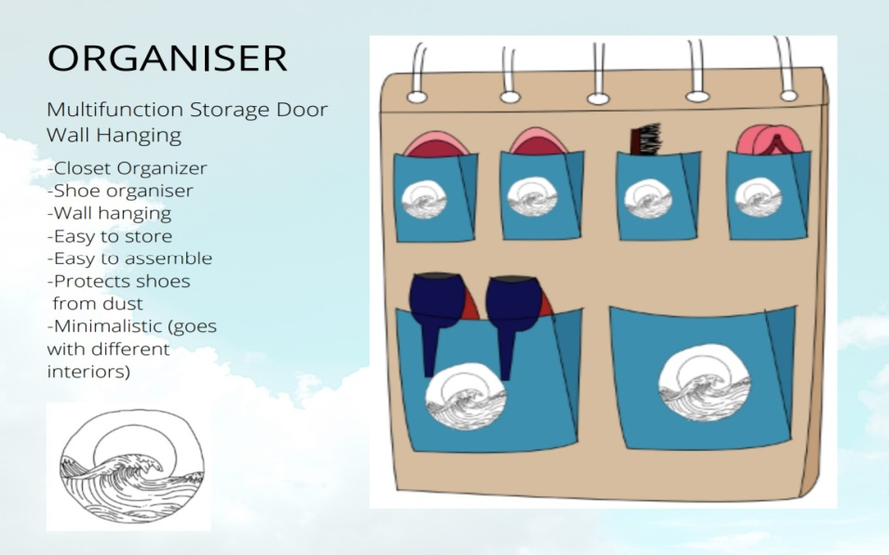
Sem– 6 Product Development For Home Fashion

Slide 22
World of Knits
Knit Art (Sem-7):
Usage of Sustainable, Up cycling, Recycling methods to arrive at design & Development of Knit Art. Art can be installation, environment art or any other relevant method (for eg: Yarn Bombing)
Yarn bombing (or yarnbombing) is a type of graffiti or street art that employs colourful displays of knitted or crocheted yarn or fibre rather than paint or chalk. It is also called wool bombing, yarn storming, guerrilla knitting, kniffiti, urban knitting, or graffiti knitting. Ref. Wikipedia

Slide 23
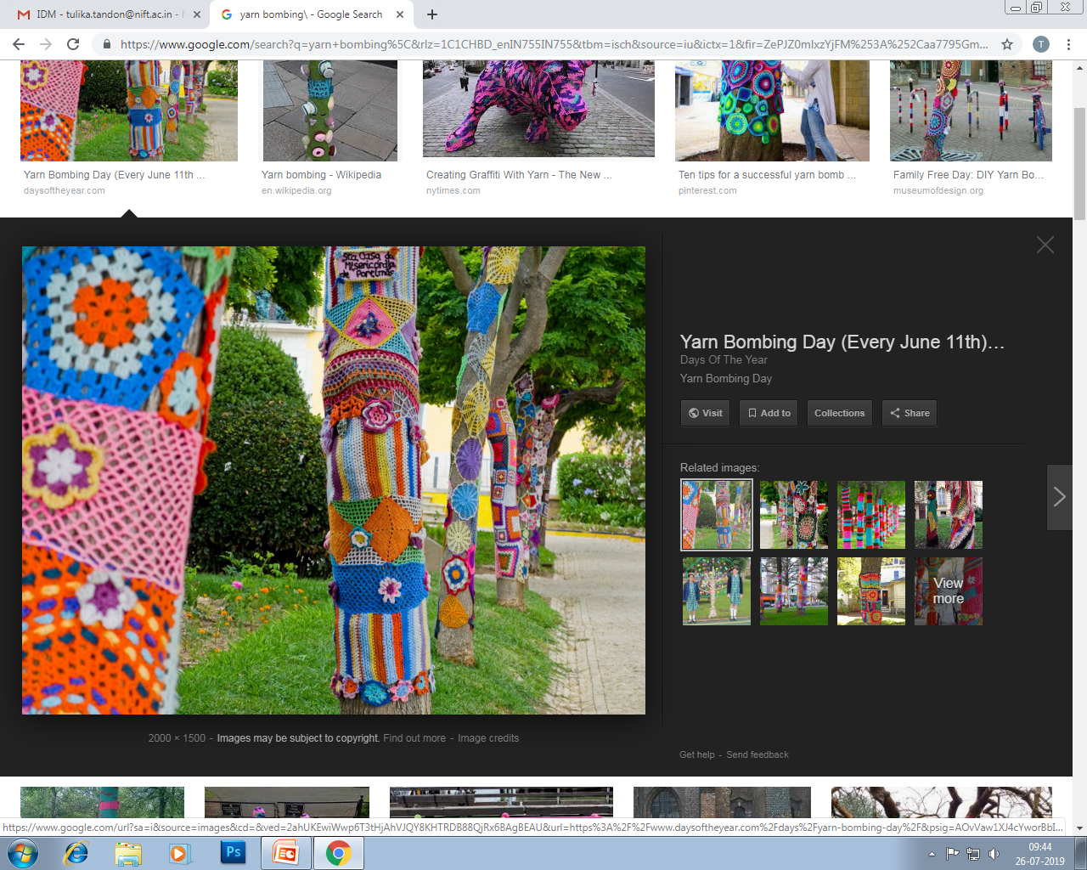
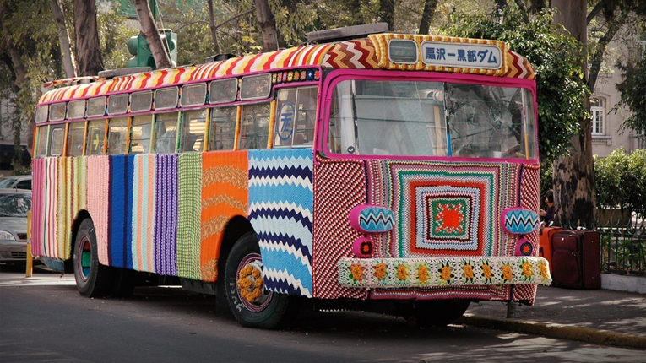
Sem– 7 Knit Art
Pic Courtesy: www.daysoftheyear.com, Youtube.com, Ted Talk.

Slide 24
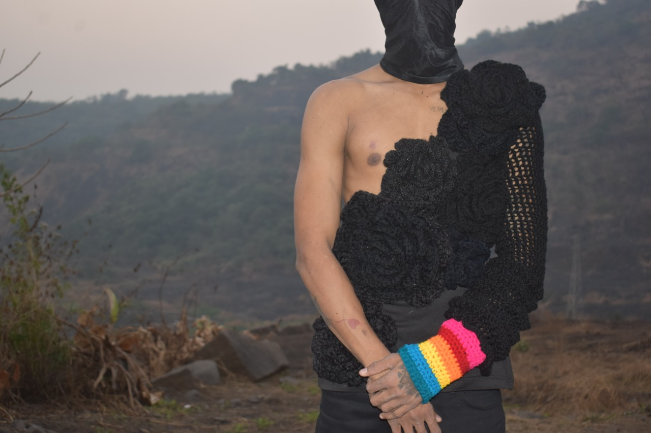
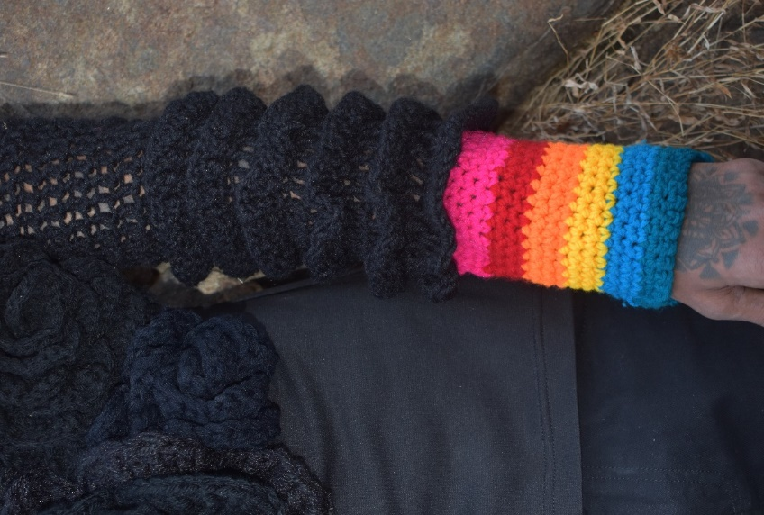
Sem– 7 Knit Art

Slide 25
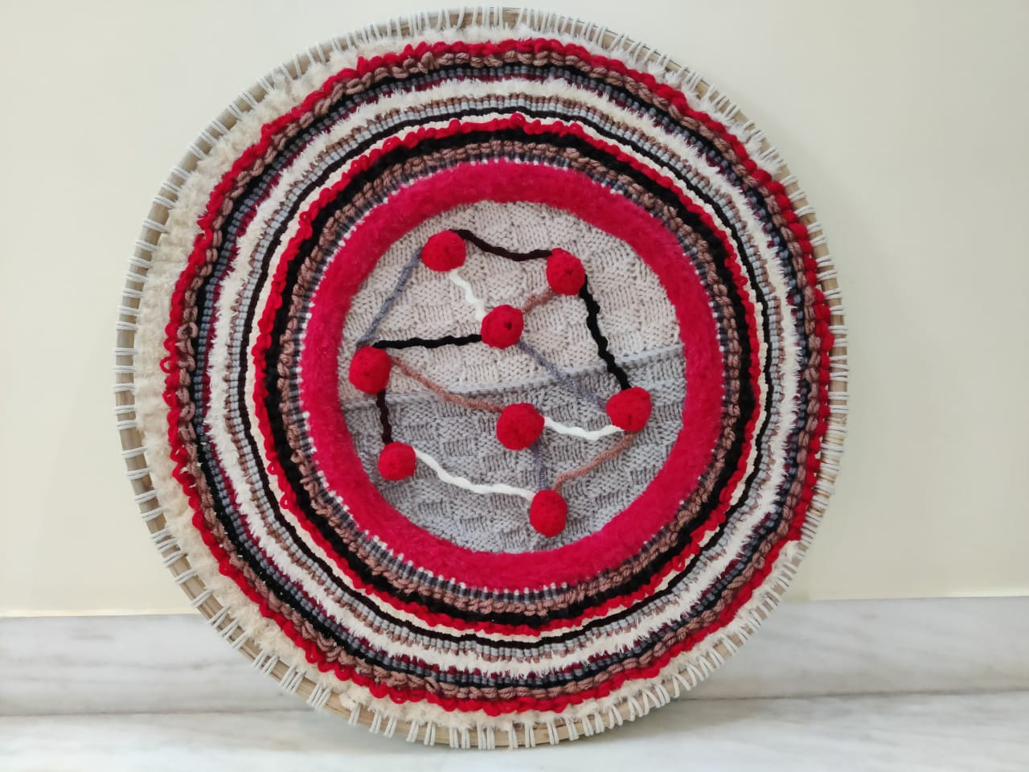
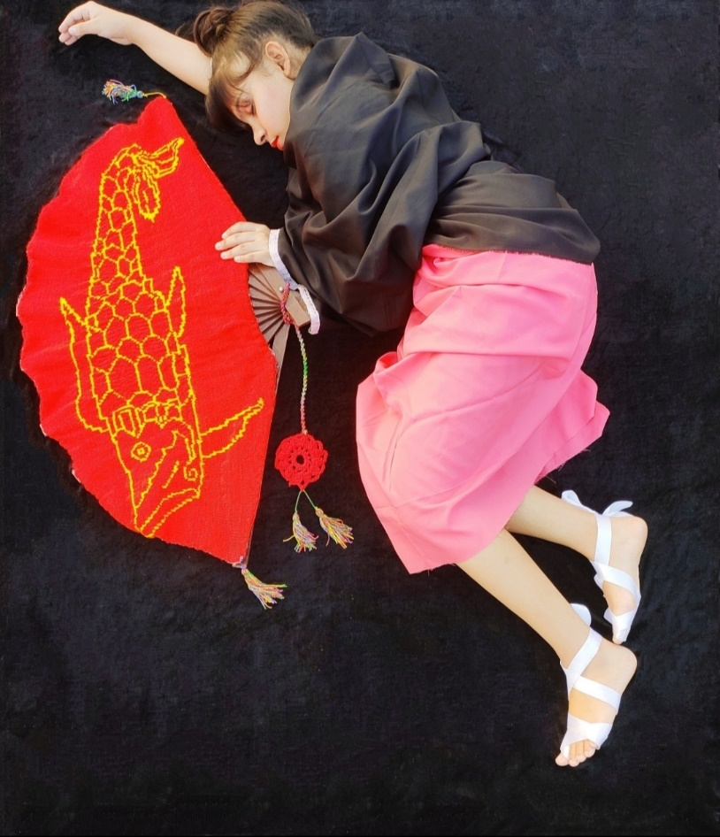
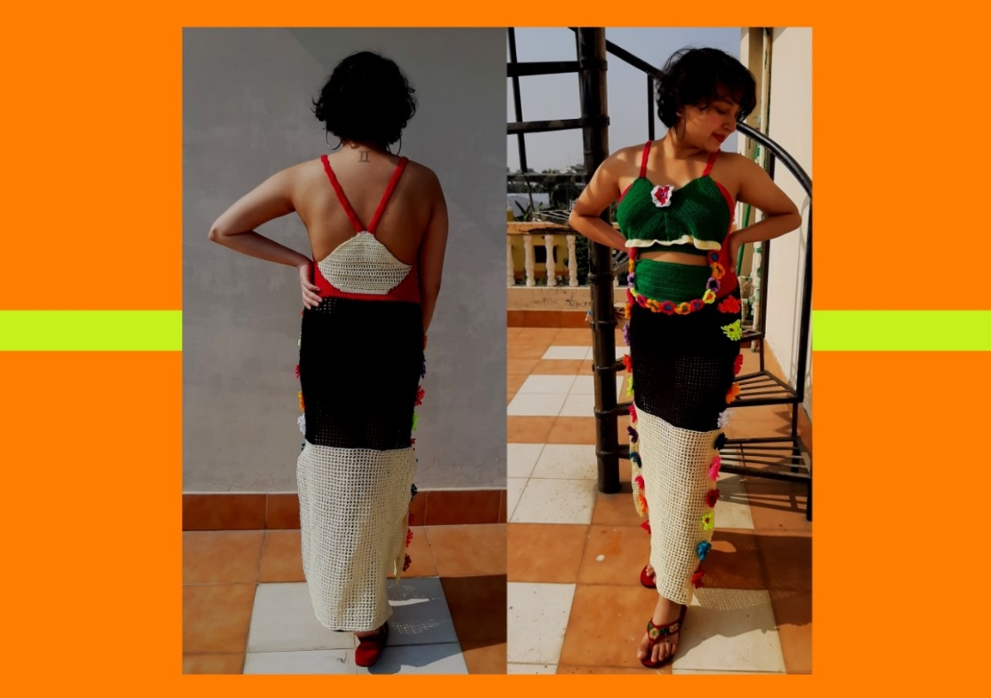
Sem– 7 Knit Art

Slide 26
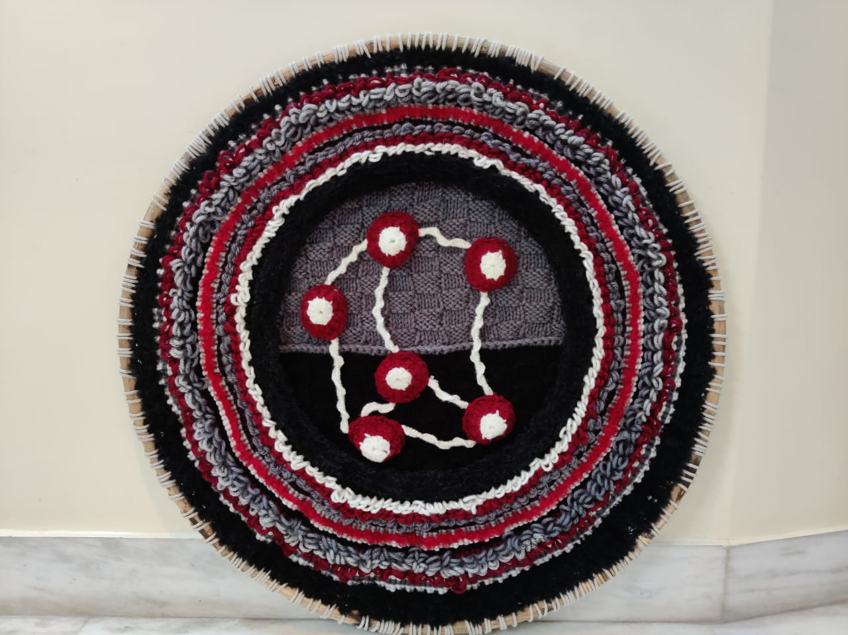
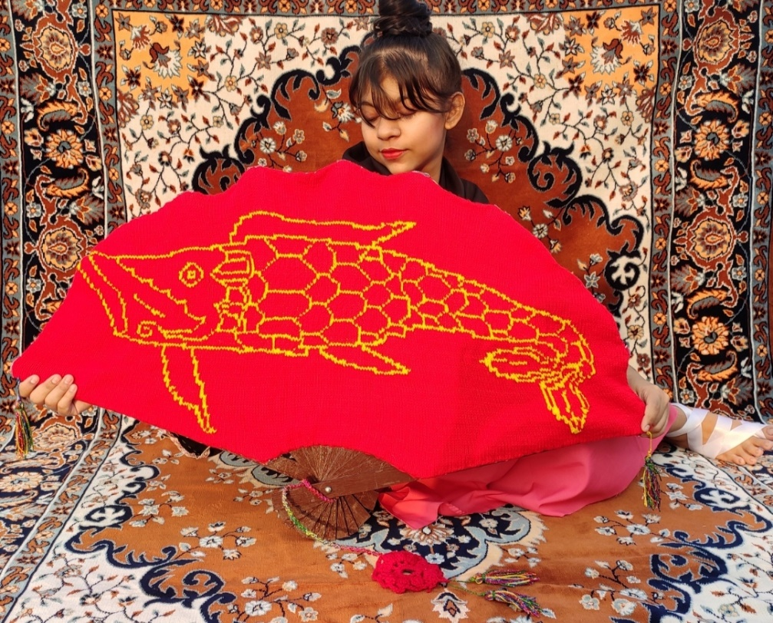
Sem– 7 Knit Art

Slide 27
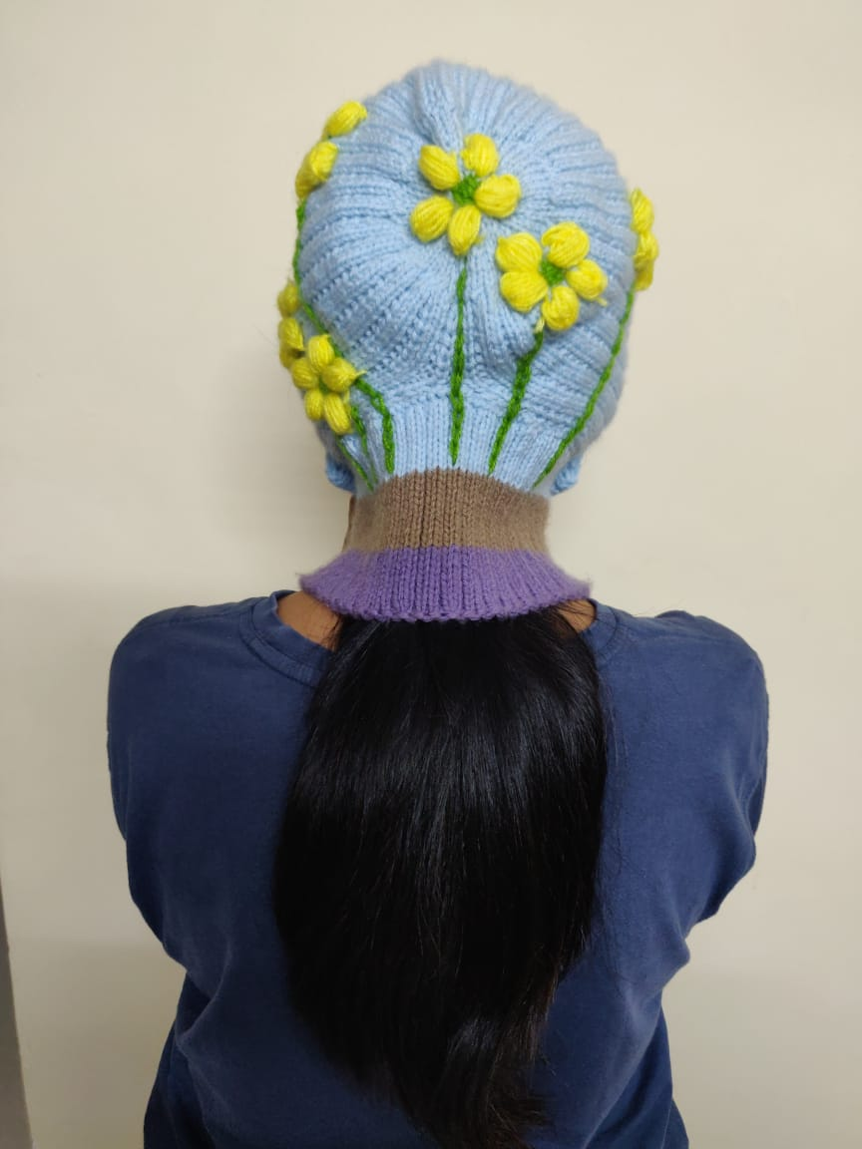
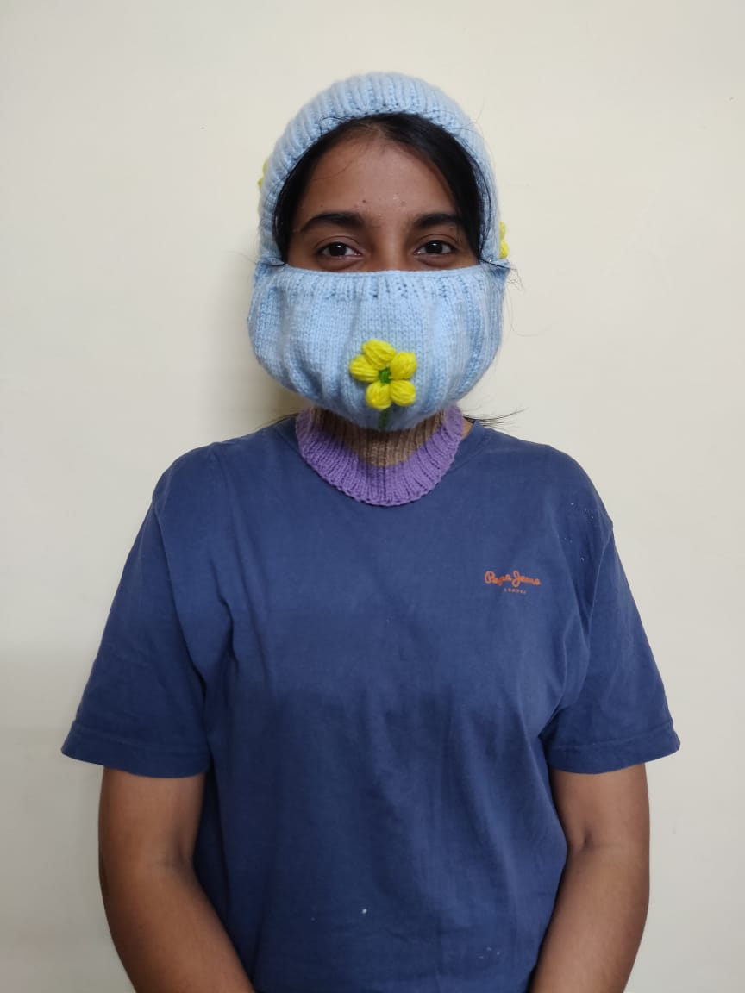
Sem– 7 Knit Art

Slide 28
Learning Outcomes
Understanding of Knitting techniques practiced across the world.
Understanding of knitting as a sustainable medium in Fashion world.
Hands on experience in developing customized garments, home products and accessories.
Knowledge of growing Knitwear market in Home segment, Apparel, Accessories and Art.
Knowledge to express creativity through knitwear as a medium to create aesthetic artworks.
Acquire the knowledge of Knitted Apparels and other Knitted products.

Slide 29
Learning Outcomes
Understanding of Machinery used for Knitting.
Knit fabric understanding – types / structures, GSM, Gauge, and other technical details.
Understanding Parameters that define Quality of Knits for various categories
Using Knits for creating art structures.

Slide 30
Thank you

